Slide 1
Qualitative Methods
Geog 360 Human Geography

Slide 2
Learning Objectives
Describe characteristics of qualitative methods
Describe participant observation methods
Describe the content & format of field notes
Analyze textual data using coding

Slide 3
1. Qualitative field research
Def. - Methods to understand people’s experiences by observing & listening to the ways in which they behave & account for their lives & activities

Slide 4
Characteristics
Creates textual or linguistic data
Provides context and history
Allows researchers to engage with informants
Involves iterative analysis
Moving back & forth betw field observations & interpretation of data
Has smaller sample sizes
More in-depth data collection; hypothesis generation as goal
Uses theoretical sampling
Informants selected on basis of targeting people engaged in topic
Uses open-ended questions
Listen to not only what is being said but how to assess motivation behind remarks

Slide 5
Benefits
Enables interpretation of actions, feelings, values, motivations and constraints shaping people’s geographic behavior
Examines ways people make sense of complex issues.
Gathers info on a range of experiences rather than the most common ones.

Slide 6
2. Participant observation (core method of ethnography)
Accurate watching and noting of phenomena
Continuum between observing and participating (see Box 7.2 p. 256-7 in Hoggart et al 2002)
Objectives
Gathering rich detail
Counting – events, objects relationship (ex: ped & bike counts)
Complementing – additional data to complement other data; collected to help target later data collection (ex: census and ground truthing)
Contextualizing – first hand experience often to supplement other knowledge (ex. Bus routes/time tables vs. riding experience)

Slide 7
Important to consider impact of action while collecting data (ethics)
Recording decisions: choice of setting, access, your position in research setting, talking and listening, recording data for recall
Participatory mapping – particular type of participation observation
Mapping socially significant patterns; locating markers

Slide 8
3. Field notes
Example in Box 7.6 p281 in Hoggart et al. & template on BeachBoard
Describe behavior
Descriptions without evaluation
Describe physical environment as if through the lens of a camera

Slide 9
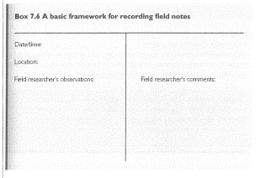

Slide 11
Week 10 Qualitative Methods continued
Geog 360 Human Geography
Week 9

Slide 12
Learning Objectives
Describe characteristics of qualitative methods
Describe participant observation methods
Describe the content & format of field notes
Analyze textual data using coding

Slide 13
4. Analyzing qualitative data
Qualitative coding - Process of creating categories to understand more generalizable patterns & explanations
Coding for themes
Theoretical code – derived from existing studies (literature), (e.g.“geography of fear” Wesely & Gaarder, 2004)

Slide 14
DE research questions
Research question(s):
What is the geography of fear and anxiety on campus?
What locations (places and spaces) are associated with feelings of fear (e.g., feeling unsafe due to risk of violence, harassment, or other physical harm or feeling violated due to loss or damage to property)
What locations are associated with feelings of anxiety (e.g., feeling anxious, nervous, or worried due to risk of failure, confrontation, being penalized, feeling uncomfortable)?

Slide 15
Coding travel diaries & field notes
Ex: DE2
Types of emotions:
What kind of emotions do students associate with places on campus?
Where and when do they feel fear?
Where and when do they feel anxious?
Fear of | Anxiety related to
Bodily harm, assault | Embarrassment
Loss of property | Failure
Damage to property | Feeling uncomfortable
Victim of crime | Worrying about being late
 | Nervous about talking/seeing someone

Slide 16
4. Types of codes (Richards)
Types of Codes
Topic – subject term, theme
Theoretical – derived from existing studies (literature ), hypotheses or research questions (e.g.“geography of fear” (Wesely & Gaarder, 2004)
Descriptive - information about case attributes like gender, age, position, size, distance, location, building type
Analytical – ideas about connections between topics; connotation; codes that indicate interpretation & reflection on meaning of the data (ex. Rationale for being there; Negative feelings; sense of place)

Slide 17
4. References on coding methods
Read chp 5 of Richards, on BeachBoard especially the boxes
Lofgren, Kent. “Qualitative analysis of interview data: A step-by-step guide” https://www.youtube.com/watch?v=DRL4PF2u9XA
Process of associating text with a category
NVIVO software
Coding
https://www.youtube.com/watch?v=z9RRAd70kuA

Slide 18
Additional Resources on Coding
What is a code?
https://www.youtube.com/watch?v=BAKRKZq_Ebo
How to Know You Are Coding Correctly: Qualitative Research Methods
https://www.youtube.com/watch?v=iL7Ww5kpnIM
Source: Duke Mod-U. Practical Modular Lessons on Social Science Methods, YOUR GUIDE TO QUALITATIVE METHODS https://modu.ssri.duke.edu/

Slide 19
Step 1: Read over diary
Step 2: In your notes or on a separate sheet of paper
Write down all the emotions mentioned.
Examples: Fear, Anxiety, Happy, Sad, Bored, Excited, etc.
List types of locations identified in diary for fear or anxiety.
Classroom, parking lot, path, bathroom, food location, etc.
List types of fear and anxiety mentioned.
Fear of | Anxiety related to
Bodily harm, assault | Embarrassment
Loss of property | Failure
Damage to property | Feeling uncomfortable
Victim of crime | Worrying about being late
 | Nervous about talking/seeing someone

Slide 20
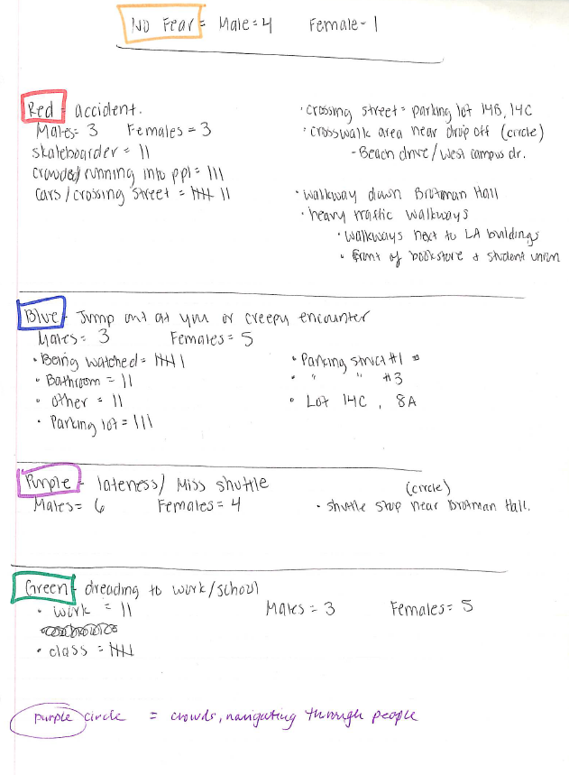
Step 3: Create codes

Slide 21
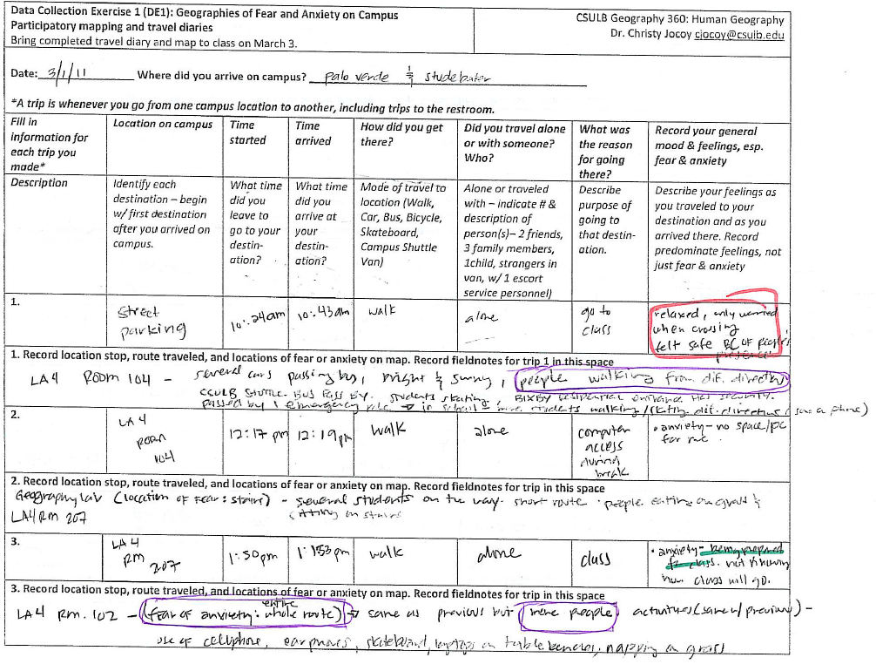
Step 4: code data

Slide 22
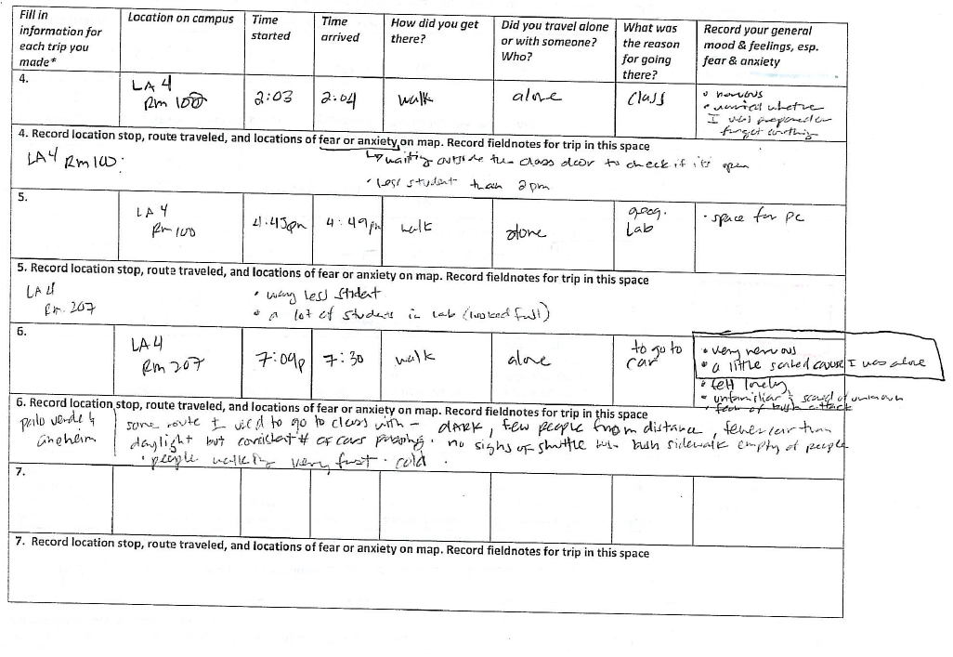

Slide 23
Step 4: Analyze Data

